Slide 1
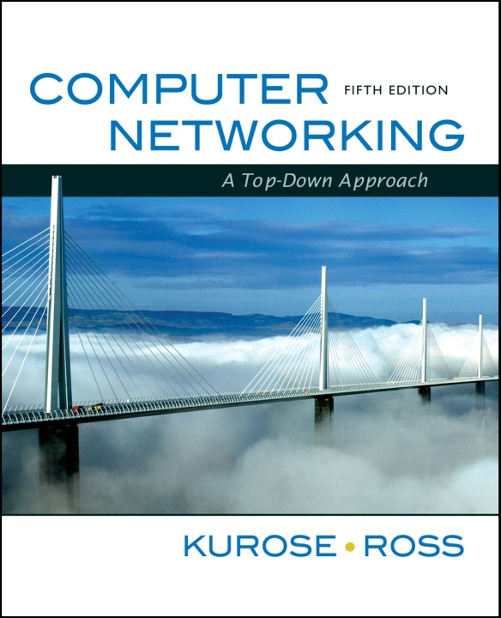
Chapter 5
Link Layer and LANs
A note on the use of these ppt slides:
We’re making these slides freely available to all (faculty, students, readers). They’re in PowerPoint form so you can add, modify, and delete slides (including this one) and slide content to suit your needs. They obviously represent a lot of work on our part. In return for use, we only ask the following:
If you use these slides (e.g., in a class) in substantially unaltered form, that you mention their source (after all, we’d like people to use our book!)
If you post any slides in substantially unaltered form on a www site, that you note that they are adapted from (or perhaps identical to) our slides, and note our copyright of this material.
Thanks and enjoy! JFK/KWR
All material copyright 1996-2009
J.F Kurose and K.W. Ross, All Rights Reserved
Computer Networking: A Top Down Approach
5th edition.
Jim Kurose, Keith Ross
Addison-Wesley, April 2009.
5: DataLink Layer
5-<number>

Slide 2
Chapter 5: The Data Link Layer
Our goals:
understand principles behind data link layer services:
  error detection, correction
  sharing a broadcast channel: multiple access
  link layer addressing
  reliable data transfer, flow control: done!
instantiation and implementation of various link layer technologies
5: DataLink Layer
5-<number>

Slide 3
Link Layer
5.1 Introduction and services
5.2 Error detection and correction
5.3Multiple access protocols
5.4 Link-layer Addressing
5.5 Ethernet
5.6 Link-layer switches
5.7 PPP
5.8 Link virtualization: MPLS
5.9 A day in the life of a web request
5: DataLink Layer
5-<number>

Slide 4

Link Layer: Introduction
Some terminology:
hosts and routers are nodes
communication channels that connect adjacent nodes along communication path are links
  wired links
  wireless links
  LANs
layer-2 packet is a frame, encapsulates datagram
data-link layer has responsibility of
transferring datagram from one node
to adjacent node over a link
5: DataLink Layer
5-<number>

Slide 5
Link layer: context
datagram transferred by different link protocols over different links:
  e.g., Ethernet on first link, frame relay on intermediate links, 802.11 on last link
each link protocol provides different services
  e.g., may or may not provide rdt over link
transportation analogy
trip from Princeton to Lausanne
  limo: Princeton to JFK
  plane: JFK to Geneva
  train: Geneva to Lausanne
tourist = datagram
transport segment = communication link
transportation mode = link layer protocol
travel agent = routing algorithm
5: DataLink Layer
5-<number>

Slide 6
Link Layer Services
framing, link access:
  encapsulate datagram into frame, adding header, trailer
  channel access if shared medium
  “MAC” addresses used in frame headers to identify source, dest
    different from IP address!
reliable delivery between adjacent nodes
  we learned how to do this already (chapter 3)!
  seldom used on low bit-error link (fiber, some twisted pair)
  wireless links: high error rates
    Q: why both link-level and end-end reliability?
5: DataLink Layer
5-<number>

Slide 7
Link Layer Services (more)
flow control:
  pacing between adjacent sending and receiving nodes
error detection:
  errors caused by signal attenuation, noise.
  receiver detects presence of errors:
    signals sender for retransmission or drops frame
error correction:
  receiver identifies and corrects bit error(s) without resorting to retransmission
half-duplex and full-duplex
  with half duplex, nodes at both ends of link can transmit, but not at same time
5: DataLink Layer
5-<number>

Slide 8



Where is the link layer implemented?
in each and every host
link layer implemented in “adaptor” (aka network interface card NIC)
  Ethernet card, PCMCI card, 802.11 card
  implements link, physical layer
attaches into host’s system buses
combination of hardware, software, firmware
host schematic
application
transport
network
link
cpu
memory
link
physical
host
bus
(e.g., PCI)
controller
physical
transmission
network adapter
card
5: DataLink Layer
5-<number>

Slide 9
Adaptors Communicating
datagram
datagram
controller
controller
sending host
receiving host
datagram
frame
sending side:
  encapsulates datagram in frame
  adds error checking bits, rdt, flow control, etc.
receiving side
  looks for errors, rdt, flow control, etc
  extracts datagram, passes to upper layer at receiving side
5: DataLink Layer
5-<number>

Slide 10
Link Layer
5.1 Introduction and services
5.2 Error detection and correction
5.3Multiple access protocols
5.4 Link-layer Addressing
5.5 Ethernet
5.6 Link-layer switches
5.7 PPP
5.8 Link virtualization: MPLS
5.9 A day in the life of a web request
5: DataLink Layer
5-<number>

Slide 11

Error Detection
EDC= Error Detection and Correction bits (redundancy)
D = Data protected by error checking, may include header fields
Error detection not 100% reliable!
  protocol may miss some errors, but rarely
  larger EDC field yields better detection and correction
otherwise
5: DataLink Layer
5-<number>

Slide 12


Parity Checking
Single Bit Parity:
Detect single bit errors
Two Dimensional Bit Parity:
Detect and correct single bit errors
0
0
5: DataLink Layer
5-<number>

Slide 13
Internet checksum (review)
Goal: detect “errors” (e.g., flipped bits) in transmitted packet (note: used at transport layer only)
Sender:
treat segment contents as sequence of 16-bit integers
checksum: addition (1’s complement sum) of segment contents
sender puts checksum value into UDP checksum field
Receiver:
compute checksum of received segment
check if computed checksum equals checksum field value:
  NO - error detected
  YES - no error detected. But maybe errors nonetheless?
5: DataLink Layer
5-<number>

Slide 14

Checksumming: Cyclic Redundancy Check
view data bits, D, as a binary number
choose r+1 bit pattern (generator), G
goal: choose r CRC bits, R, such that
  <D,R> exactly divisible by G (modulo 2)
  receiver knows G, divides <D,R> by G. If non-zero remainder: error detected!
  can detect all burst errors less than r+1 bits
widely used in practice (Ethernet, 802.11 WiFi, ATM)
5: DataLink Layer
5-<number>

Slide 15

CRC Example
Want:
  D.2^{r} XOR R = nG
equivalently:
  D.2^{r} = nG XOR R
equivalently:
if we divide D.2^{r} by G, want remainder R
D.2^{r}
G
R = remainder[ ]
5: DataLink Layer
5-<number>

Slide 16
Link Layer
5.1 Introduction and services
5.2 Error detection and correction
5.3Multiple access protocols
5.4 Link-layer Addressing
5.5 Ethernet
5.6 Link-layer switches
5.7 PPP
5.8 Link virtualization: MPLS
5.9 A day in the life of a web request
5: DataLink Layer
5-<number>

Slide 17




Multiple Access Links and Protocols
Two types of “links”:
point-to-point
  PPP for dial-up access
  point-to-point link between Ethernet switch and host
broadcast (shared wire or medium)
  old-fashioned Ethernet
  upstream HFC
  802.11 wireless LAN
humans at a
cocktail party
(shared air, acoustical)
shared wire (e.g.,
cabled Ethernet)
shared RF
(e.g., 802.11 WiFi)
shared RF
(satellite)
5: DataLink Layer
5-<number>

Slide 18
Multiple Access protocols
single shared broadcast channel
two or more simultaneous transmissions by nodes: interference
  collision if node receives two or more signals at the same time
multiple access protocol
distributed algorithm that determines how nodes share channel, i.e., determine when node can transmit
communication about channel sharing must use channel itself!
  no out-of-band channel for coordination
5: DataLink Layer
5-<number>

Slide 19
Ideal Multiple Access Protocol
Broadcast channel of rate R bps
1. when one node wants to transmit, it can send at rate R.
2. when M nodes want to transmit, each can send at average rate R/M
3. fully decentralized:
  no special node to coordinate transmissions
  no synchronization of clocks, slots
4. simple
5: DataLink Layer
5-<number>

Slide 20
MAC Protocols: a taxonomy
Three broad classes:
Channel Partitioning
  divide channel into smaller “pieces” (time slots, frequency, code)
  allocate piece to node for exclusive use
Random Access
  channel not divided, allow collisions
  “recover” from collisions
“Taking turns”
  nodes take turns, but nodes with more to send can take longer turns
5: DataLink Layer
5-<number>

Slide 21
Channel Partitioning MAC protocols: TDMA
TDMA: time division multiple access
access to channel in "rounds"
each station gets fixed length slot (length = pkt trans time) in each round
unused slots go idle
example: 6-station LAN, 1,3,4 have pkt, slots 2,5,6 idle
6-slot
frame
1
3
4
1
3
4
5: DataLink Layer
5-<number>

Slide 22
Channel Partitioning MAC protocols: FDMA
FDMA: frequency division multiple access
channel spectrum divided into frequency bands
each station assigned fixed frequency band
unused transmission time in frequency bands go idle
example: 6-station LAN, 1,3,4 have pkt, frequency bands 2,5,6 idle
time
frequency bands
FDM cable
5: DataLink Layer
5-<number>

Slide 23
Random Access Protocols
When node has packet to send
  transmit at full channel data rate R.
  no a priori coordination among nodes
two or more transmitting nodes ➜ “collision”,
random access MAC protocol specifies:
  how to detect collisions
  how to recover from collisions (e.g., via delayed retransmissions)
Examples of random access MAC protocols:
  slotted ALOHA
  ALOHA
  CSMA, CSMA/CD, CSMA/CA
5: DataLink Layer
5-<number>

Slide 24
Slotted ALOHA
Assumptions:
all frames same size
time divided into equal size slots (time to transmit 1 frame)
nodes start to transmit only slot beginning
nodes are synchronized
if 2 or more nodes transmit in slot, all nodes detect collision
Operation:
when node obtains fresh frame, transmits in next slot
  if no collision: node can send new frame in next slot
  if collision: node retransmits frame in each subsequent slot with prob. p until success
5: DataLink Layer
5-<number>

Slide 25

Slotted ALOHA
Pros
single active node can continuously transmit at full rate of channel
highly decentralized: only slots in nodes need to be in sync
simple
Cons
collisions, wasting slots
idle slots
nodes may be able to detect collision in less than time to transmit packet
clock synchronization
5: DataLink Layer
5-<number>

Slide 26
Slotted Aloha efficiency
Efficiency : long-run
fraction of successful slots
(many nodes, all with many frames to send)
max efficiency: find p* that maximizes
Np(1-p)^{N-1}
for many nodes, take limit of Np*(1-p*)^{N-1} as N goes to infinity, gives:
Max efficiency = 1/e = .37
suppose: N nodes with many frames to send, each transmits in slot with probability p
prob that given node has success in a slot = p(1-p)^{N-1}
prob that any node has a success = Np(1-p)^{N-1}
At best: channel
used for useful
transmissions 37%
of time!
!
5: DataLink Layer
5-<number>

Slide 27

Pure (unslotted) ALOHA
unslotted Aloha: simpler, no synchronization
when frame first arrives
  transmit immediately
collision probability increases:
  frame sent at t₀ collides with other frames sent in [t₀-1,t₀+1]
5: DataLink Layer
5-<number>

Slide 28
Pure Aloha efficiency
P(success by given node) = P(node transmits) .
P(no other node transmits in [p₀-1,p₀] .
P(no other node transmits in [p₀-1,p₀]
= p . (1-p)^{N-1 .} (1-p)^{N-1}
= p . (1-p)^{2(N-1)}
… choosing optimum p and then letting n -> infty ...
^{= 1/(2e) = .18}
even worse than slotted Aloha!
5: DataLink Layer
5-<number>

Slide 29
CSMA (Carrier Sense Multiple Access)
CSMA: listen before transmit:
If channel sensed idle: transmit entire frame
If channel sensed busy, defer transmission
human analogy: don’t interrupt others!
5: DataLink Layer
5-<number>

Slide 30

CSMA collisions
spatial layout of nodes
collisions can still occur:
propagation delay means
two nodes may not hear
each other’s transmission
collision:
entire packet transmission
time wasted
note:
role of distance & propagation delay in determining collision probability
5: DataLink Layer
5-<number>

Slide 31
CSMA/CD (Collision Detection)
CSMA/CD: carrier sensing, deferral as in CSMA
  collisions detected within short time
  colliding transmissions aborted, reducing channel wastage
collision detection:
  easy in wired LANs: measure signal strengths, compare transmitted, received signals
  difficult in wireless LANs: received signal strength overwhelmed by local transmission strength
human analogy: the polite conversationalist
5: DataLink Layer
5-<number>

Slide 32

CSMA/CD collision detection
5: DataLink Layer
5-<number>

Slide 33
“Taking Turns” MAC protocols
channel partitioning MAC protocols:
  share channel efficiently and fairly at high load
  inefficient at low load: delay in channel access, 1/N bandwidth allocated even if only 1 active node!
Random access MAC protocols
  efficient at low load: single node can fully utilize channel
  high load: collision overhead
“taking turns” protocols
  look for best of both worlds!
5: DataLink Layer
5-<number>

Slide 34
“Taking Turns” MAC protocols
Polling:
master node “invites” slave nodes to transmit in turn
typically used with “dumb” slave devices
concerns:
  polling overhead
  latency
  single point of failure (master)
data
poll
master
data
slaves
5: DataLink Layer
5-<number>

Slide 35
“Taking Turns” MAC protocols
Token passing:
control token passed from one node to next sequentially.
token message
concerns:
  token overhead
  latency
  single point of failure (token)
T
(nothing
to send)
T
data
5: DataLink Layer
5-<number>

Slide 36
Summary of MAC protocols
channel partitioning, by time, frequency or code
  Time Division, Frequency Division
random access (dynamic),
  ALOHA, S-ALOHA, CSMA, CSMA/CD
  carrier sensing: easy in some technologies (wire), hard in others (wireless)
  CSMA/CD used in Ethernet
  CSMA/CA used in 802.11
taking turns
  polling from central site, token passing
  Bluetooth, FDDI, IBM Token Ring
5: DataLink Layer
5-<number>

Slide 37
Link Layer
5.1 Introduction and services
5.2 Error detection and correction
5.3Multiple access protocols
5.4 Link-Layer Addressing
5.5 Ethernet
5.6 Link-layer switches
5.7 PPP
5.8 Link virtualization: MPLS
5.9 A day in the life of a web request
5: DataLink Layer
5-<number>

Slide 38

Ethernet
“dominant” wired LAN technology:
cheap $20 for NIC
first widely used LAN technology
simpler, cheaper than token LANs and ATM
kept up with speed race: 10 Mbps – 10 Gbps
Metcalfe’s Ethernet
sketch
5: DataLink Layer
5-<number>

Slide 39
Star topology
bus topology popular through mid 90s
  all nodes in same collision domain (can collide with each other)
today: star topology prevails
  active switch in center
  each “spoke” runs a (separate) Ethernet protocol (nodes do not collide with each other)
switch
bus: coaxial cable
star
5: DataLink Layer
5-<number>

Slide 40

Ethernet Frame Structure
Sending adapter encapsulates IP datagram (or other network layer protocol packet) in Ethernet frame
Preamble:
7 bytes with pattern 10101010 followed by one byte with pattern 10101011
used to synchronize receiver, sender clock rates
5: DataLink Layer
5-<number>

Slide 41
Ethernet Frame Structure (more)
Addresses: 6 bytes
  if adapter receives frame with matching destination address, or with broadcast address (eg ARP packet), it passes data in frame to network layer protocol
  otherwise, adapter discards frame
Type: indicates higher layer protocol
CRC: checked at receiver, if error is detected, frame is dropped
5: DataLink Layer
5-<number>

Slide 42
Ethernet: Unreliable, connectionless
connectionless: No handshaking between sending and receiving NICs
unreliable: receiving NIC doesn’t send acks or nacks to sending NIC
  stream of datagrams passed to network layer can have gaps (missing datagrams)
  gaps will be filled if app is using TCP
  otherwise, app will see gaps
Ethernet’s MAC protocol: unslotted CSMA/CD
5: DataLink Layer
5-<number>

Slide 43
Ethernet CSMA/CD algorithm
1. NIC receives datagram from network layer, creates frame
2. If NIC senses channel idle, starts frame transmission If NIC senses channel busy, waits until channel idle, then transmits
3. If NIC transmits entire frame without detecting another transmission, NIC is done with frame !
4. If NIC detects another transmission while transmitting, aborts and sends jam signal
5. After aborting, NIC enters exponential backoff: after mth collision, NIC chooses K at random from
{0,1,2,…,2^{m}-1}. NIC waits K·512 bit times, returns to Step 2
5: DataLink Layer
5-<number>

Slide 44
Ethernet’s CSMA/CD (more)
Jam Signal: make sure all other transmitters are aware of collision; 48 bits
Bit time: .1 microsec for 10 Mbps Ethernet ;
for K=1023, wait time is about 50 msec
5: DataLink Layer
5-<number>

Slide 45
802.3 Ethernet Standards: Link & Physical Layers
many different Ethernet standards
  common MAC protocol and frame format
  different speeds: 2 Mbps, 10 Mbps, 100 Mbps, 1Gbps, 10G bps
  different physical layer media: fiber, cable
application
transport
network
link
physical
MAC protocol
and frame format
100BASE-TX
100BASE-T2
100BASE-FX
100BASE-T4
100BASE-SX
100BASE-BX
copper (twister
pair) physical layer
fiber physical layer
5: DataLink Layer
5-<number>

Slide 46

Manchester encoding
used in 10BaseT
each bit has a transition
allows clocks in sending and receiving nodes to synchronize to each other
  no need for a centralized, global clock among nodes!
Hey, this is physical-layer stuff!
5: DataLink Layer
5-<number>

Slide 47
Link Layer
5.1 Introduction and services
5.2 Error detection and correction
5.3 Multiple access protocols
5.4 Link-layer Addressing
5.5 Ethernet
5.6 Link-layer switches, LANs, VLANs
5.7 PPP
5.8 Link virtualization: MPLS
5.9 A day in the life of a web request
5: DataLink Layer
5-<number>

Slide 48
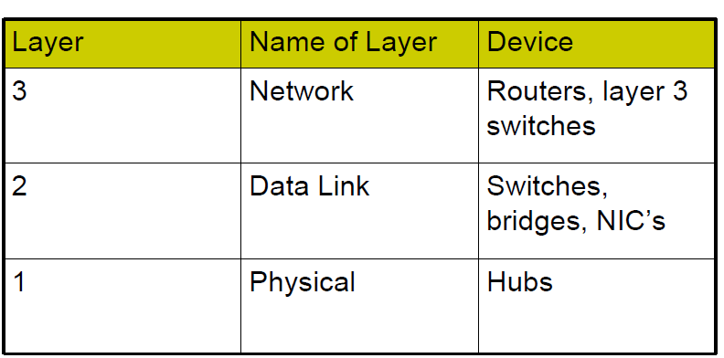
Devices and the layers at which they operate
5: DataLink Layer
5-<number>

Slide 49
Hubs
  bits coming in one link go out all other links at same rate
  all nodes connected to hub can collide with one another
  no frame buffering
  no CSMA/CD at hub: host NICs detect collisions
twisted pair
hub
5: DataLink Layer
5-<number>

Slide 50
Switch
link-layer device: smarter than hubs, take active role
  store, forward Ethernet frames
  examine incoming frame’s MAC address, selectively forward frame to one-or-more outgoing links when frame is to be forwarded on segment, uses CSMA/CD to access segment
transparent
  hosts are unaware of presence of switches
plug-and-play, self-learning
  switches do not need to be configured
5: DataLink Layer
5-<number>

Slide 51
Switch: allows multiple simultaneous transmissions
A
hosts have dedicated, direct connection to switch
switches buffer packets
Ethernet protocol used on each incoming link, but no collisions; full duplex
  each link is its own collision domain
switching: A-to-A’ and B-to-B’ simultaneously, without collisions
  not possible with dumb hub
C’
B
1
2
6
3
5
4
C
B’
A’
switch with six interfaces
(1,2,3,4,5,6)
5: DataLink Layer
5-<number>

Slide 52
Switch Table
A
Q: how does switch know that A’ reachable via interface 4, B’ reachable via interface 5?
A: each switch has a switch table, each entry:
  (MAC address of host, interface to reach host, time stamp)
looks like a routing table!
Q: how are entries created, maintained in switch table?
  something like a routing protocol?
C’
B
1
2
6
3
5
4
C
B’
A’
switch with six interfaces
(1,2,3,4,5,6)
5: DataLink Layer
5-<number>

Slide 53
Switch: self-learning
Source: A
Dest: A’
A
A A’
switch learns which hosts can be reached through which interfaces
  when frame received, switch “learns” location of sender: incoming LAN segment
  records sender/location pair in switch table
C’
B
1
2
6
3
5
4
C
B’
A’
MAC addr interface TTL
A
1
60
Switch table
(initially empty)
5: DataLink Layer
5-<number>

Slide 54
Switch: frame filtering/forwarding
When frame received:
1. record link associated with sending host
2. index switch table using MAC dest address
3. if entry found for destination
then {
if dest on segment from which frame arrived
then drop the frame
else forward the frame on interface indicated
}
else flood
forward on all but the interface
on which the frame arrived
5: DataLink Layer
5-<number>

Slide 55
Self-learning, forwarding: example
Source: A
Dest: A’
A
A A’
C’
B
frame destination unknown:
1
2
flood
6
3
A A’
A A’
A A’
A A’
A A’
5
4
destination A location known:
C
selective send
A’ A
B’
A’
MAC addr interface TTL
A
1
60
Switch table
(initially empty)
A’
4
60
5: DataLink Layer
5-<number>

Slide 56
Interconnecting switches
switches can be connected together
S₄
S₁
S₃
A
S₂
F
I
B
C
D
E
G
H
Q: sending from A to G - how does S₁ know to forward frame destined to F via S₄ and S₃?
A: self learning! (works exactly the same as in single-switch case!)
5: DataLink Layer
5-<number>

Slide 57
Self-learning multi-switch example
Suppose C sends frame to I, I responds to C
1
S₄
S₁
2
S₃
A
S₂
F
I
B
C
D
E
G
H
Q: show switch tables and packet forwarding in S₁, S₂, S₃, S₄
5: DataLink Layer
5-<number>

Slide 58
Institutional network
mail server
to external
network
router
web server
IP subnet
5: DataLink Layer
5-<number>

Slide 59
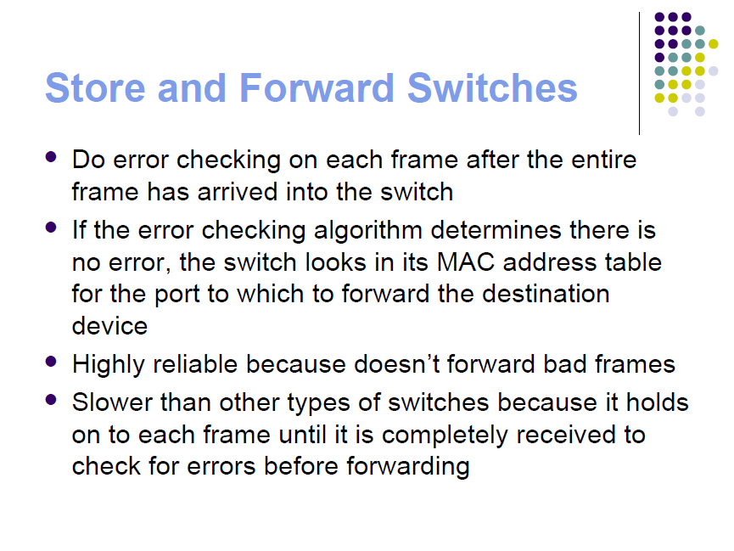
5: DataLink Layer
5-<number>

Slide 60
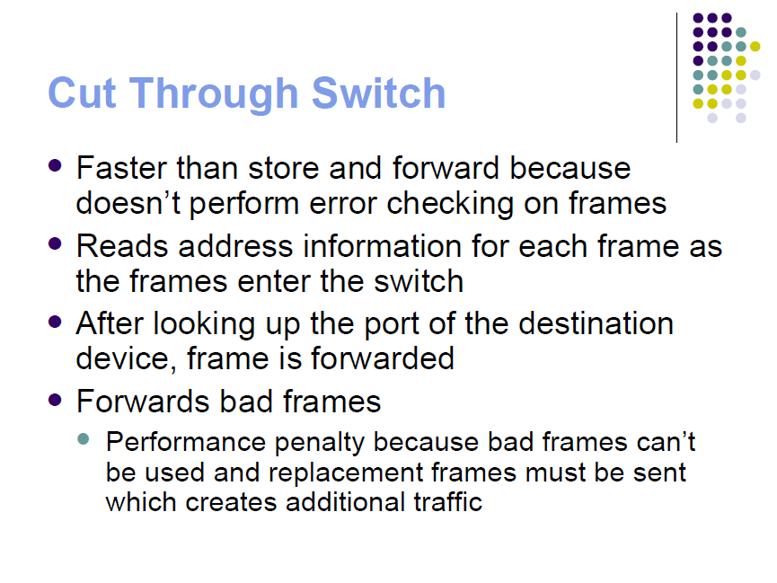
5: DataLink Layer
5-<number>

Slide 61
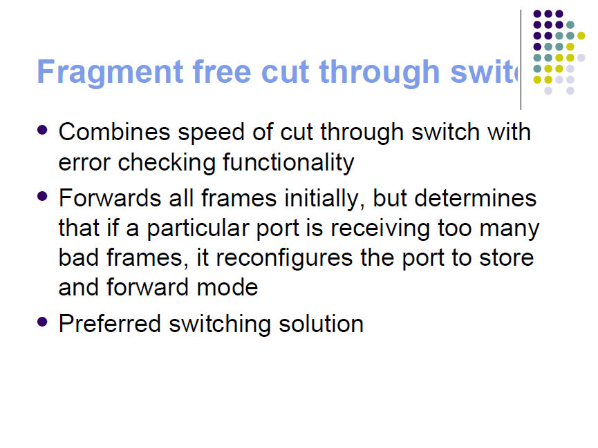
5: DataLink Layer
5-<number>

Slide 62

Switches vs. Routers
both store-and-forward devices
  routers: network layer devices (examine network layer headers)
  switches are link layer devices
routers maintain routing tables, implement routing algorithms
switches maintain switch tables, implement filtering, learning algorithms
5: DataLink Layer
5-<number>

Slide 63
Layer 2 Devices: Bridges
• Operate at the Data Link layer of the OSI
model
• Filters traffic between network segments
by examining the destination MAC address
– Based on this destination MAC address, the
bridge either forwards or discards the frame
– When a client sends a broadcast frame to
the entire network, the bridge will always
forward the frame
5: DataLink Layer
5-<number>

Slide 64
Transparent Bridges : Also called learning
bridges because they build a table of MAC
addresses as they receive frames
– This means that they “learn” which addresses
are on which segments
– Ethernet networks mainly use transparent
bridges
• Source-routing bridges : Rely on the
source of the frame transmission to
provide the routing information
– Usually employed by Token Ring networks
• Translation bridges : Can connect
networks with different architectures
5: DataLink Layer
5-<number>

Slide 65
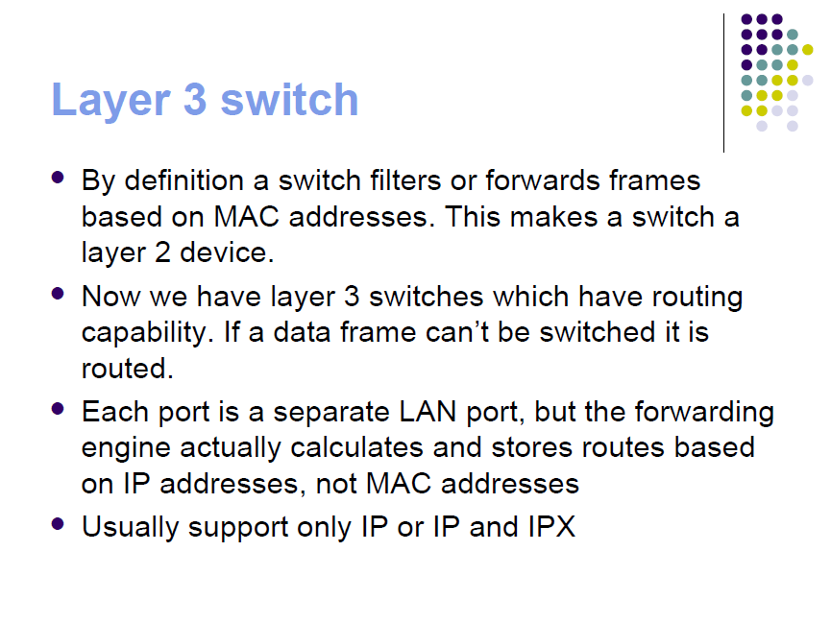
5: DataLink Layer
5-<number>

Slide 66
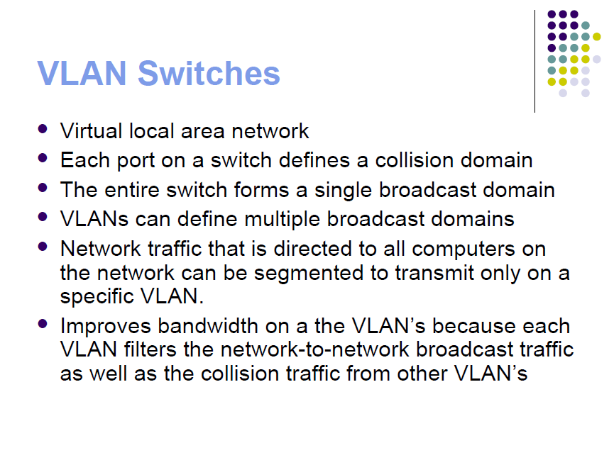
5: DataLink Layer
5-<number>

Slide 67
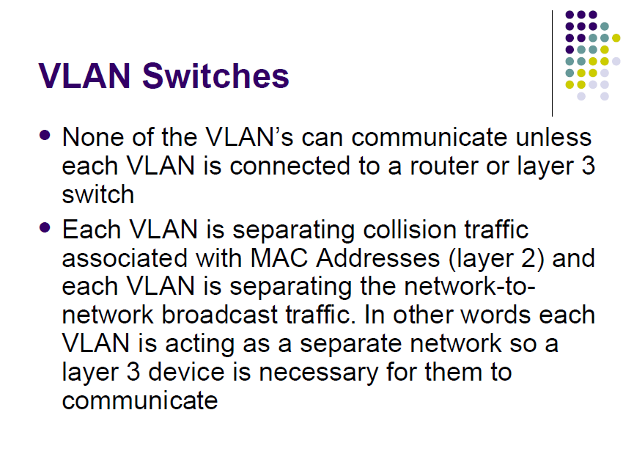
5: DataLink Layer
5-<number>

Slide 68
VLANs: motivation
What’s wrong with this picture?
What happens if:
CS user moves office to EE, but wants connect to CS switch?
single broadcast domain:
  all layer-2 broadcast traffic (ARP, DHCP) crosses entire LAN (security/privacy, efficiency issues)
each lowest level switch has only few ports in use
Computer
Science
Computer
Engineering
Electrical
Engineering
5: DataLink Layer
5-<number>

Slide 69

VLANs
Port-based VLAN: switch ports grouped (by switch management software) so that single physical switch ……
Virtual Local
Area Network
1
7
9
15
2
8
10
16
…
…
Switch(es) supporting VLAN capabilities can be configured to define multiple virtual LANS over single physical LAN infrastructure.
Electrical Engineering
(VLAN ports 1-8)
Computer Science
(VLAN ports 9-15)
… operates as multiple virtual switches
1
7
9
15
2
8
10
16
…
…
Electrical Engineering
(VLAN ports 1-8)
Computer Science
(VLAN ports 9-16)
5: DataLink Layer
5-<number>

Slide 70
Port-based VLAN
router
traffic isolation: frames to/from ports 1-8 can only reach ports 1-8
  can also define VLAN based on MAC addresses of endpoints, rather than switch port
1
7
9
15
2
8
10
16
dynamic membership: ports can be dynamically assigned among VLANs
…
…
Electrical Engineering
(VLAN ports 1-8)
Computer Science
(VLAN ports 9-15)
forwarding between VLANS: done via routing (just as with separate switches)
  in practice vendors sell combined switches plus routers
5: DataLink Layer
5-<number>

